Slide 1
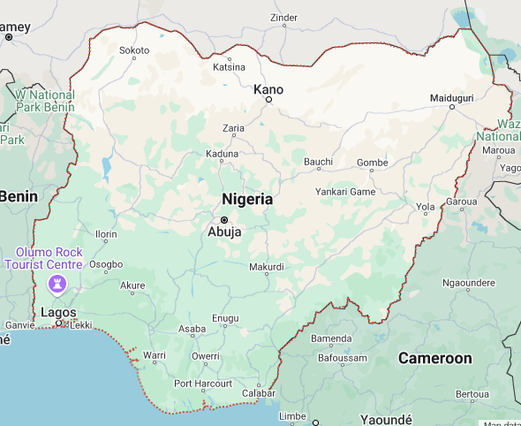

About Me
Major Ethnic Groups:
Igbo
Yoruba
Hausa
Jollof Rice

Slide 2
About Me
Name: Chukwukaodinaka Bryan Obieyisi
Background:
Born in Nigeria
Joined PMT-2/Nexus in 2021
Hobbies:
Pickleball
Soccer
Calisthenics
All outdoor activities – except camping in the presence of wild animals
Chess
Special Skill:
Can do a one hand spin
Limited to one cycle

Slide 3
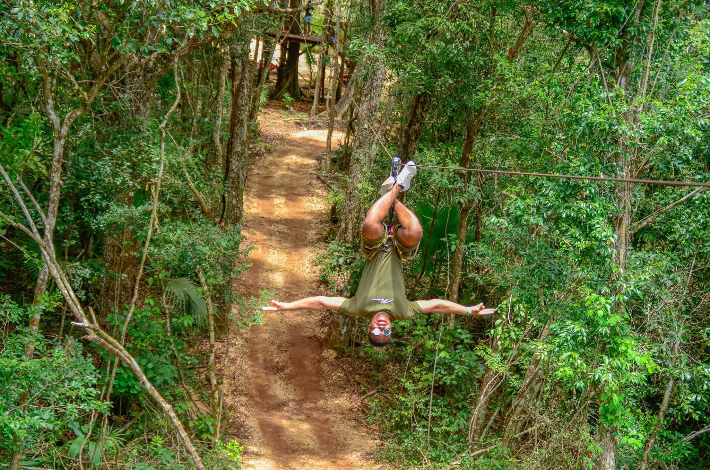

Slide 4
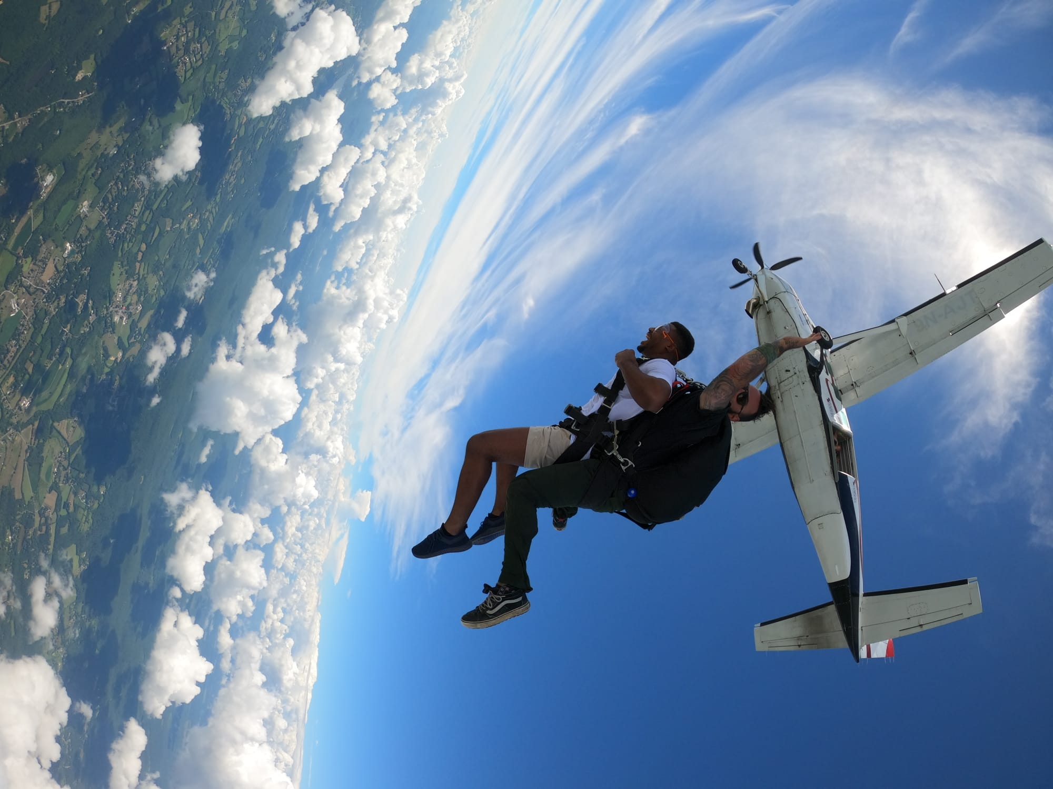
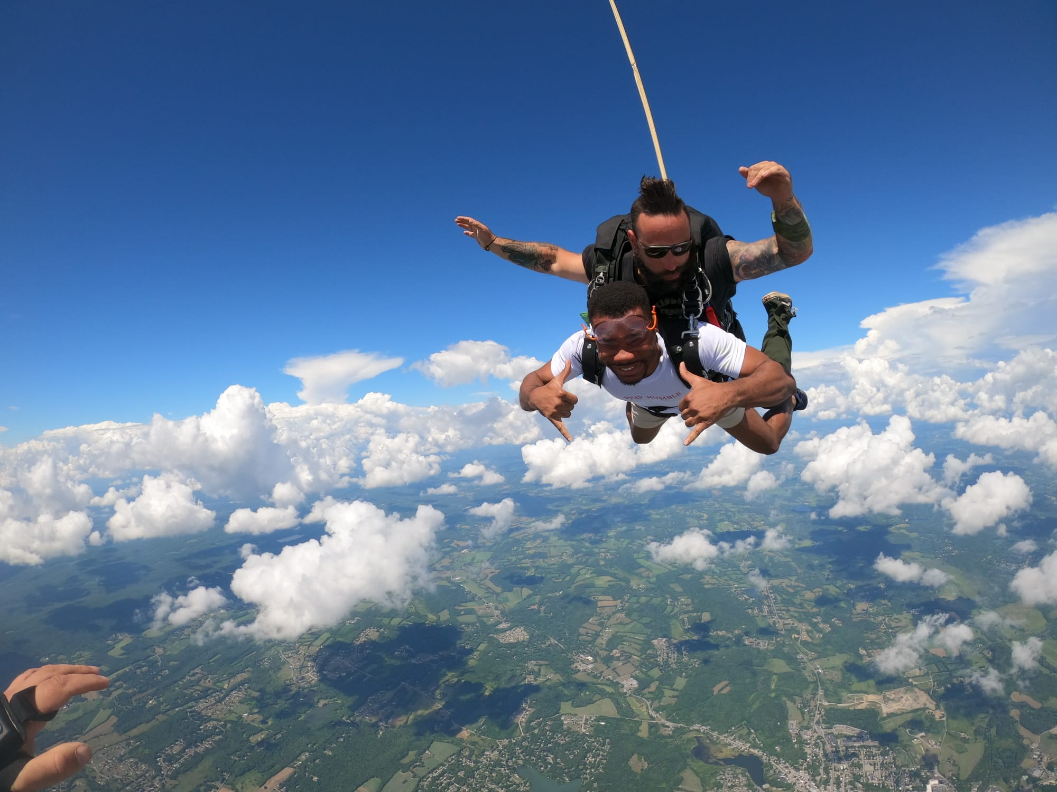

Slide 5
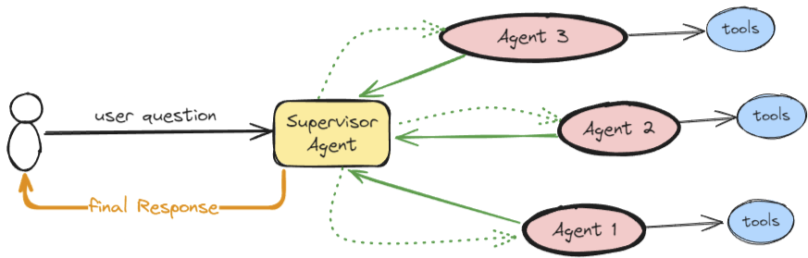
Interests:
A.I Agent Orchestration
LangChain
LangGraph
OpenAI Agent SDK

